Slide 1
Luk Fook Financial Project Bitcoin + Stock Pitch
Tam Tsun Hei Gerald, Tam Tsun Li Nicholas

Slide 2
The fall of cable entertainment
Clear that a majority of the next generation has slowly shifted away from traditional platforms of entertainment such as cable tv and have moved more towards streaming platforms. (E.g. Universal Studios releasing Trolls World Tour in video form on demand)
Future seems to steer towards on demand services, as Netflix and Amazon Prime create their own original movies
Netflix is already a major household name, so high profits are not guaranteed
So how do we profit off of this change?
Notes:
Raise your hand if you watch cable tv. Now raise your hand if you use streaming platforms. It is clear that a majority of the next generation has slowly shifted away from traditional platforms of entertainment such as cable tv and have moved more towards streaming platforms.
Even in the film industry, it’s possible to highlight a recent case study of the movie - Trolls World Tour: due to the coronavirus outbreak, Universal studios decided to stray away from traditional theatres and instead released to video on demand (services such as amazon prime, disney plus…). Although some may argue that the theatre experience of a cinema cannot be replaced and it will take time to see the change in the entertainment landscape the future seems to be steering towards these on demand services as we start to see services such as netflix and amazon prime video start to create their original movies, advancing from simply being a streaming service.
However simply purchasing shares of netflix may not guarantee high profits as it is already a big name in the game.
So how do we profit off of this change?

Slide 3
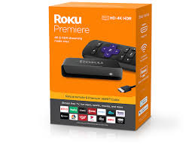
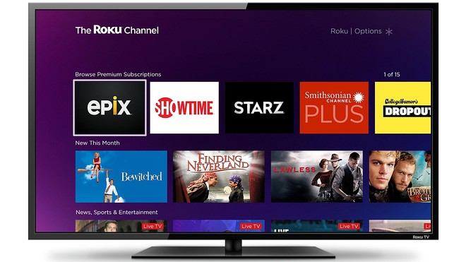
What is Roku?
Founded by current CEO Anthony Wood - a former Netflix executive
Business model: Platform that connects the ecosystem of streaming media, allows to not only use other streaming services but also allows you to watch free movies and shows on their own Roku channel
#1 smart TV OS in the US
Rather than competing with already big streaming services such as Netflix, it actually does the opposite and makes partners out of supposed ”competitors”
Revenue: Roku generates platform revenue from advertising sales, subscription and transaction revenue share, sales of branded channel buttons on remote controls, and licensing arrangements with TV brands and service operators
Sale surge of 55% in the last quarter

Slide 4
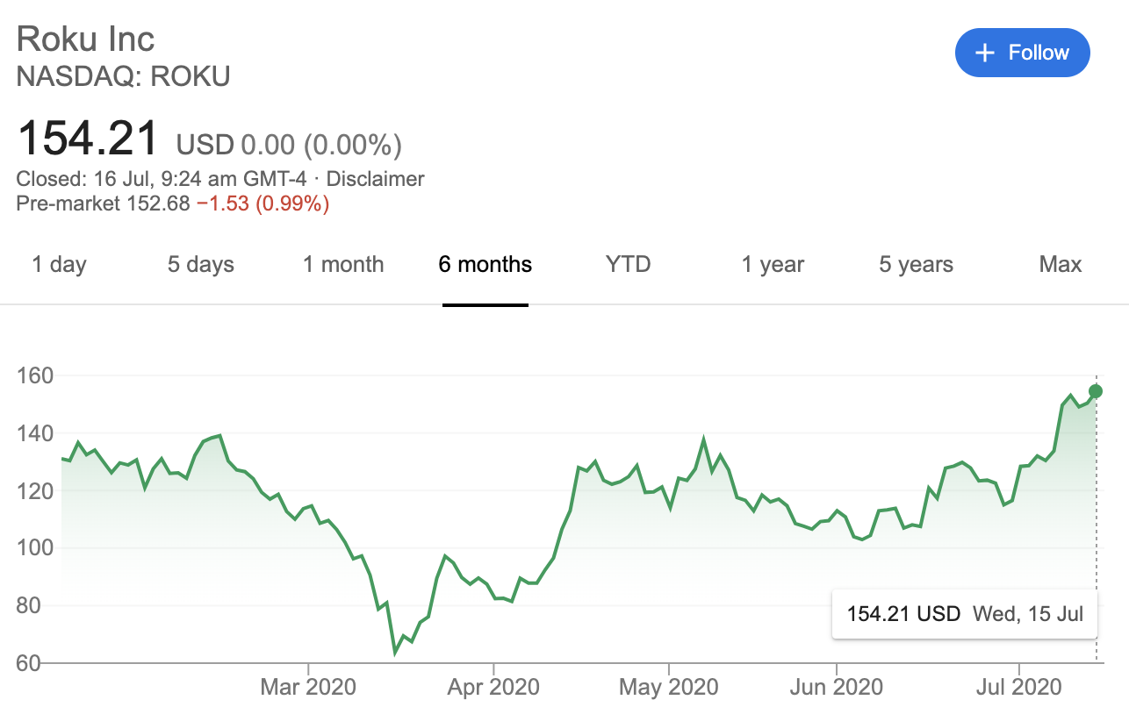
Roku Stock
Long term high growth potential
Long term investment
We are currently seeing high growth due to streaming services being used more often during coronavirus
Currently not profitable, all profits being pumped back into advertising and research and development expenses
One of biggest winners of coronavirus, yet share prices are down by 13%
According to data from S&P global market intelligence Roku gained 337% in 2019
Dividend of 3%
Large cap company with market cap of 18.6 billion USD
Stock prices increased by 40% in past month

Slide 5
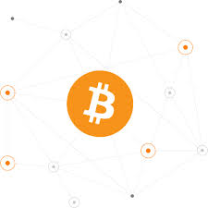
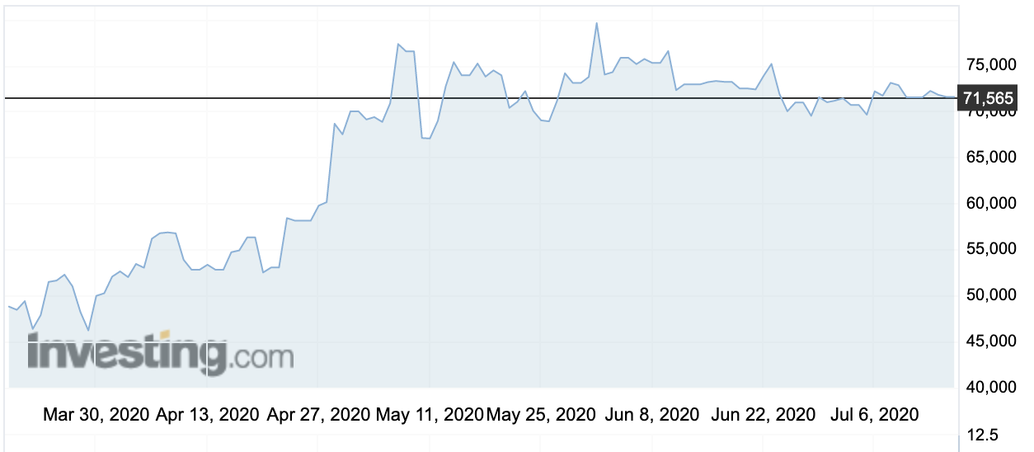
Bitcoin
Most well-known form of cryptocurrency
As of 8th July 2020, 7:39 a.m., 1 bitcoin is valued at approximately 72,000 HKD
Created by “Satoshi Nakamoto” (Real name unknown) in January 2009
Intended to provide lower transaction fees than traditional online payment systems, and is operated by a decentralised authority

Slide 6
What is cryptocurrency?
Digital form of currency meant to be a medium of exchange
Completely decentralised from governments and central clearing authorities
Uses cryptography to operate by preventing third parties from being involved in the transaction
Requires a computer algorithm, a public key (Identity shared with other people), and a private key (User’s unique signature)
Transaction steps:
Transaction details (e.g. Time, amount, participants) go through the algorithm with the user’s private key
Digitally signed output is produced and distributed across the system with the sender’s public key
Transaction is verified, added to a block in the Blockchain and given a hash (Unique identifier)

Slide 7
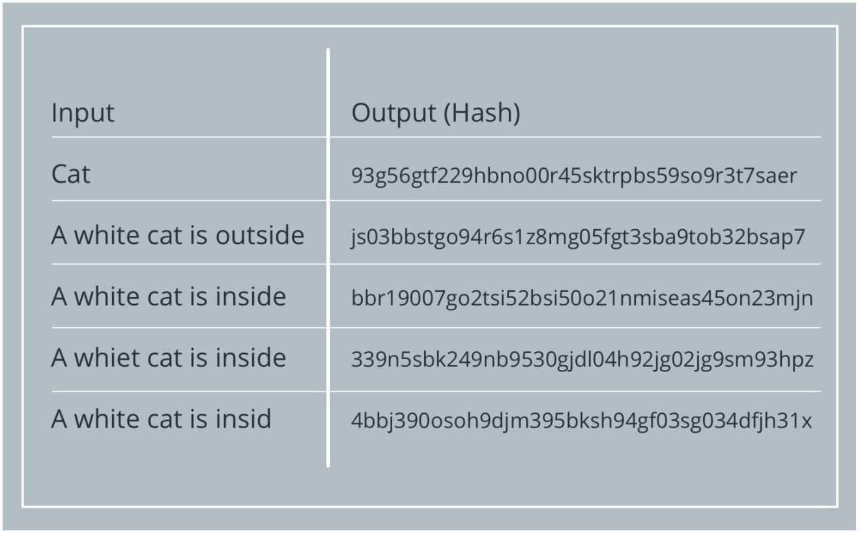
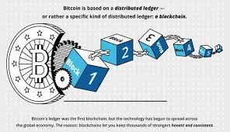
Blockchain
Blockchain: Public decentralised collection of all financial (cryptocurrency) transactions across a peer-to-peer computer network, allowing transactions to occur without requiring a central clearing authority (e.g. Shanghai Clearing House)
Used for fund transfers, trades, and storing cryptocurrencies
Ensures legitimacy of transactions due to how minor changes can create completely new hashes

Slide 8
Methods of obtaining Bitcoins
Buying them on an exchange platform
Exchange for goods and services
Mining
Process of adding Bitcoin transaction records (Bitcoins) to the Blockchain
Requires solving computationally difficult math puzzles on the network using powerful computers to discover new Bitcoins, then have the transaction information verified by the miners
Bitcoin miners gain Bitcoins in exchange for mining

Slide 9
Cryptocurrency Pros and Cons
Positives | Negatives
Portability and speed (Minimal transaction cost, transaction complete in minutes) Inflation resistance Transparency (More reliable) Reduced risk from complications in central authority (e.g. Hacking, technical failure, limit of funds) Alternative to physical currencies | Use in illegal activities No protection from problems that central authorities would provide (e.g. Security breach, taxation) Vulnerabilities of lying infrastructure (e.g. Hacking, technical failure, malware) Exchange rate volatility (Can change significantly within a day) Limit of total amount available
Notes:
Cryptocurrencies are easily portable and have very fast transactions, with a transaction completing in minutes, and having minimal costs for the transaction itself
Not affected by inflation as drastically as other currencies
Being able to access the important relevant information makes cryptocurrency transactions somewhat more reliable
There are reduced risks from complications in central authorities, due to lacking a central authority
Alternative to physical currencies
Cryptocurrencies can be used in activities such as black market transactions, money laundering, illegal activities or tax evasion due to a lack of a central authority
There is no protection from problems that central authorities would provide, such as from security breaches or taxation
The lying infrastructure may suffer similar complications in central authorities
The exchange rate of cryptocurrencies is extremely volatile and can change significantly within a single day
There is a limit on the total number of cryptocurrencies available

Slide 10
Sources
https://www.pwc.com/us/en/industries/financial-services/fintech/bitcoin-blockchain-cryptocurrency.html#:~:text=Bitcoin%20is%20the%20name%20of,verify%20the%20transfer%20of%20funds.
https://www.investopedia.com/terms/b/blockchain.asp
https://www.cnbc.com/2014/01/23/cnbc-explains-how-to-mine-bitcoins-on-your-own.html#:~:text=There%20are%20three%20primary%20ways,the%20verification%20of%20bitcoin%20transactions.
https://cointelegraph.com/bitcoin-for-beginners/what-is-mining
https://money.usnews.com/money/blogs/the-smarter-mutual-fund-investor/slideshows/how-to-pick-stocks-7-things-you-should-know?slide=2
https://www.youtube.com/watch?v=8NgVGnX4KOw

